Slide 1
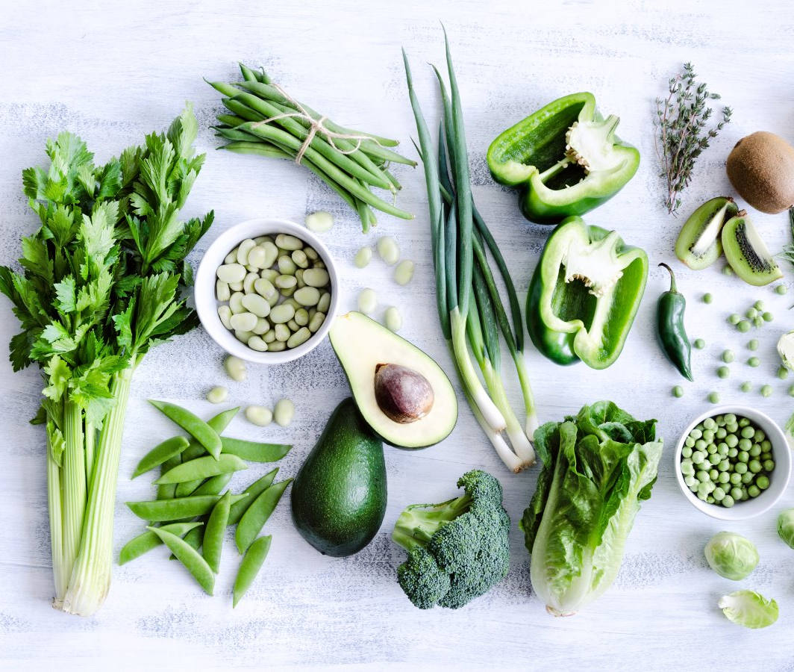


AGRO DATA ANALYTICS​
Vegetables & Beans
Project Guided By: Prof Eddy Zhang
Aravind Panchanathan
Mayuri Jadhav
Suparna Mannava
Sujatha Ganesan

Slide 2




OUR TEAM
Aravind Panchanathan
Mayuri Jadhav
Suparna Mannava
Sujatha Ganesan

Slide 3








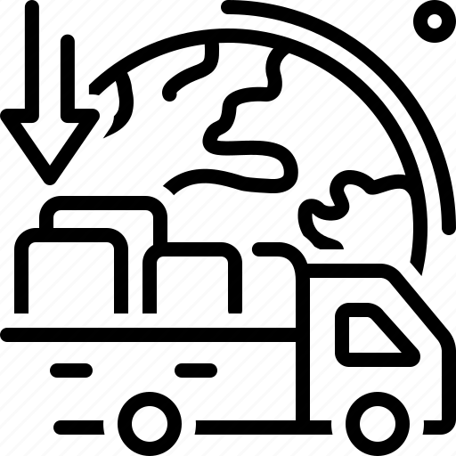

DATASET
Total Columns: 10
Total Rows: 39154
VEGETABLES
BEANS
CONTENTS
FRESH
CANNED
FROZEN
PROCESSED
CATEGORIES
BEGINNING STOCKS
PRODUCTION STOCKS
IMPORTS
EXPORTS
SEED USE
ENDING STOCKS
FEED, SHRINK AND SPOILAGE

Slide 4


RESEARCH QUESTION

Slide 5
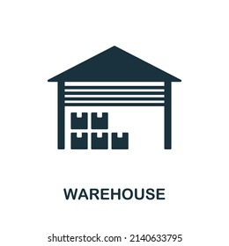
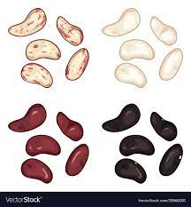

RESEARCH QUESTION -1
Do decadal trends in domestic availability of vegetables and beans correlate with changes in the ratio of ending stocks to domestic availability? Can this ratio be used to identify potential periods of scarcity or surplus across decades, and if so, does the difference between beginning and ending stocks act as a buffer during these periods?
Scarcity
Surplus
High Ending Stocks
High Ending Stocks

Slide 6


RESEARCH QUESTION -2
Ending Stocks
Impact of Imports on Domestic Availability and Stock Levels: Does increased domestic availability of a particular vegetable or pulse lead to decreased imports and lower ending stocks? Alternatively, do high import volumes suppress domestic production, leading to lower domestic availability and reliance on beginning stocks?
Domestic Production & Availability
Domestic Availability
Imports
Finding The balance
High Import Volumes

Slide 7

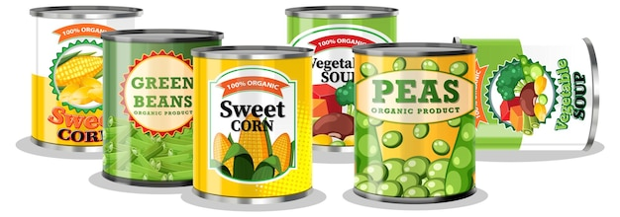
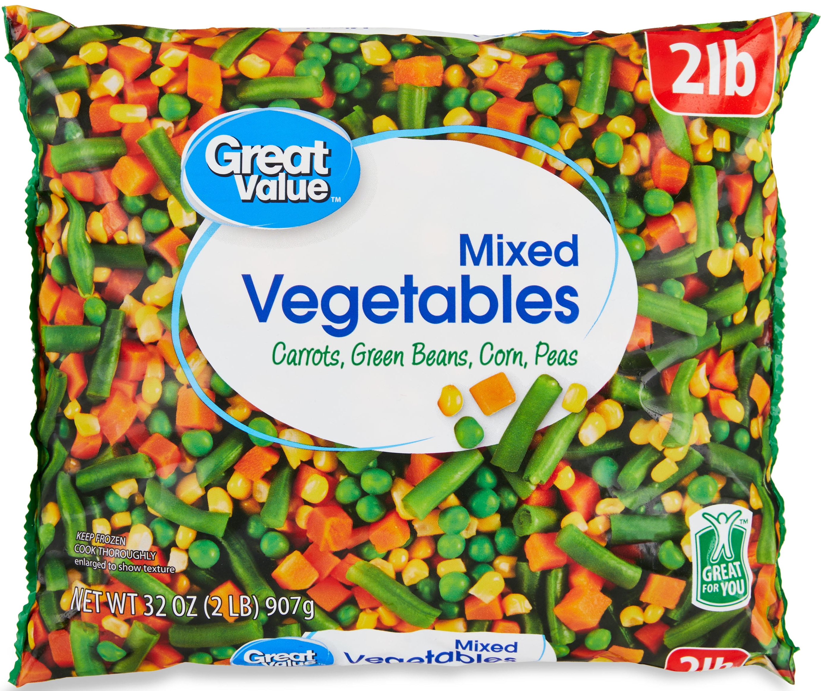
RESEARCH QUESTION -3
Shelf Life & Stock Depletion
Spoilage and Storage Efficiency: Is there a relationship between the type of vegetable/pulse (fresh, canned, frozen) and the difference between beginning and ending stocks? Do vegetables with shorter shelf life (fresh) show higher ending stock depletion compared to canned or frozen options?
Fresh Vegetables
and Beans
Canned Vegetables
and Beans
Frozen Vegetables
and Beans
Fresh vs. Canned vs. Frozen

Slide 8

DATA ENGINEERING

Slide 9












DATA PIPELINE & ARCHITECTURE
Local Host/Server

Slide 10











S3 TO DATABRICKS CONNECTION
S3
Settings
Role
Admin Settings
Bucket
Security
Inline Policy
Instance Profile
Permissions
Trusted Relationships
Access to bucket & bucketfiles
databricks-serverless-<workspace id>
“arn:aws:s3:::<bucketname>”
“arn:aws:s3:::<bucketname>/*”
<Instance ARN id>
<Role ARN id>
Bucket Policy

Slide 11






DATABRICKS TO TABLEAU CONNECTION
DATABRICKS ODBC DRIVER
x
Partner Connect
Select Tableau Connector
User Authentication

Slide 12



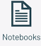
DATABRICKS TO GITHUB CONNECTION
GIT INTEGRATION
USER SETTINGS
DATABRICKS REPOS
GITHUB REPOSITORY
CREATE A BRANCH
CREATE NOTEBOOK
PUSH CHANGES TO GIT

Slide 13

DATA ANALYTICS

Slide 14
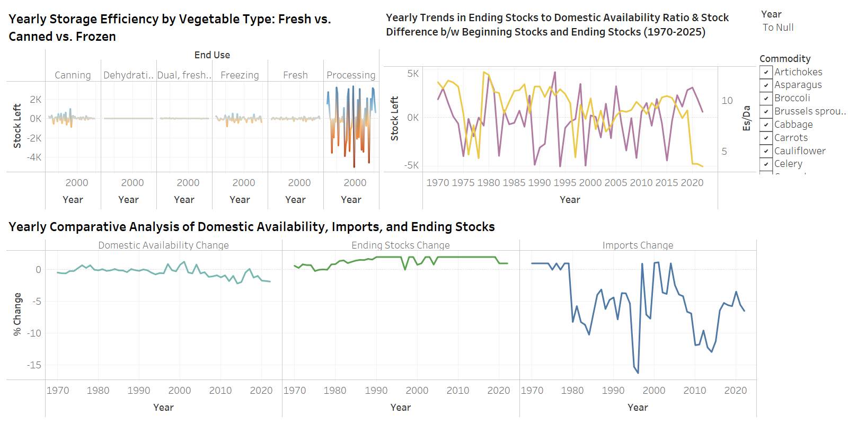
Vegetables Trends in US (1970-2020)

Slide 15
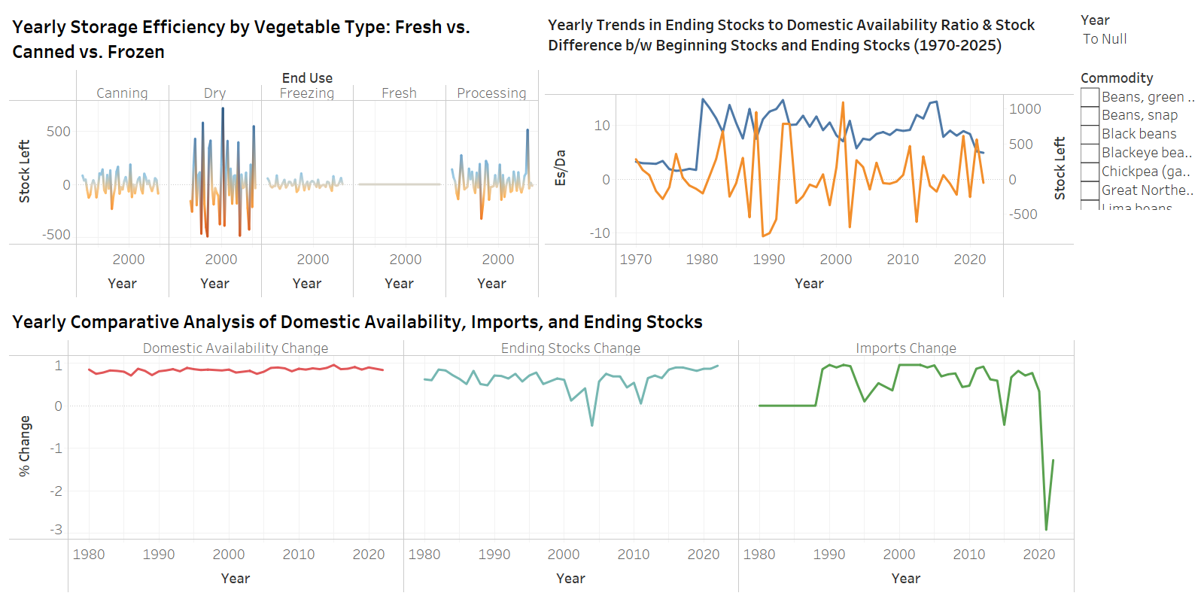
Beans Trends in US (1980-2020)

Slide 16
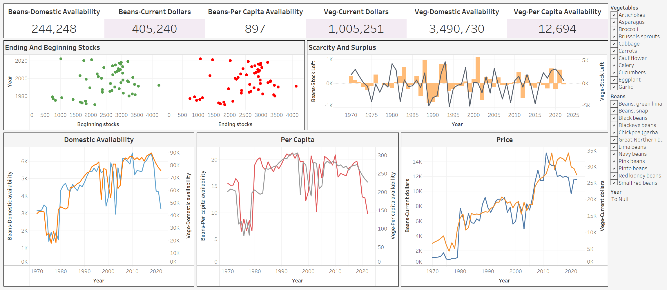
Veggies & Beans Trends in the US (1970-2020)

Slide 17

DATA MINING

Slide 18

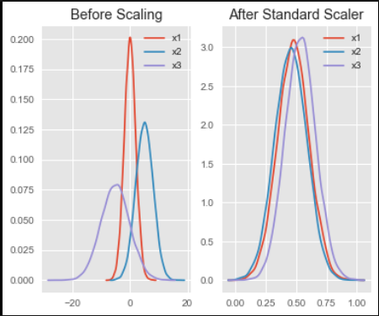

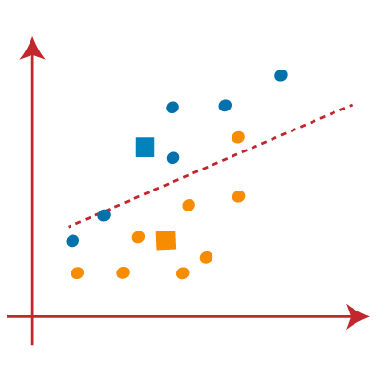





K-Means Clustering
Scalar Normalization
Feature Selection
K-means Clustering
Clustering Metrics
S3 Bucket
Silhouette Score

Slide 19
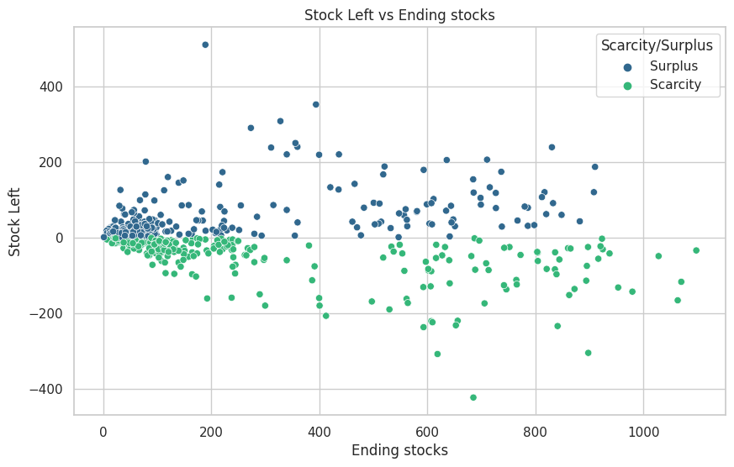
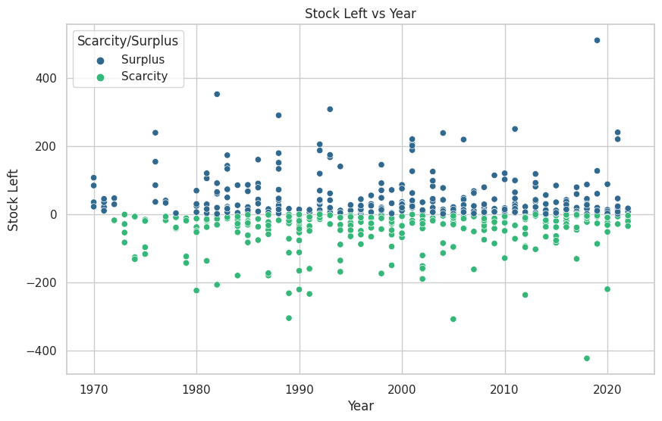
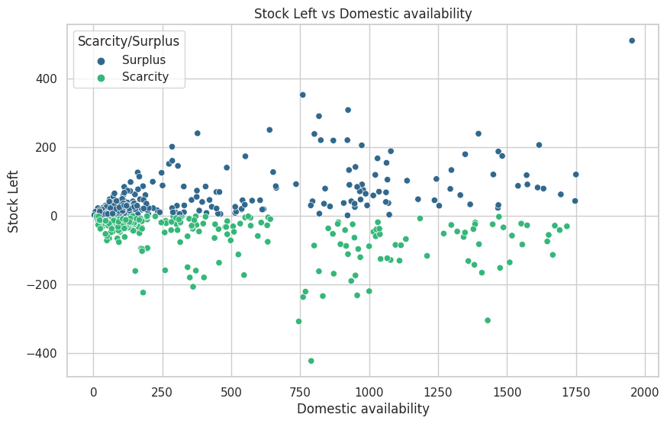
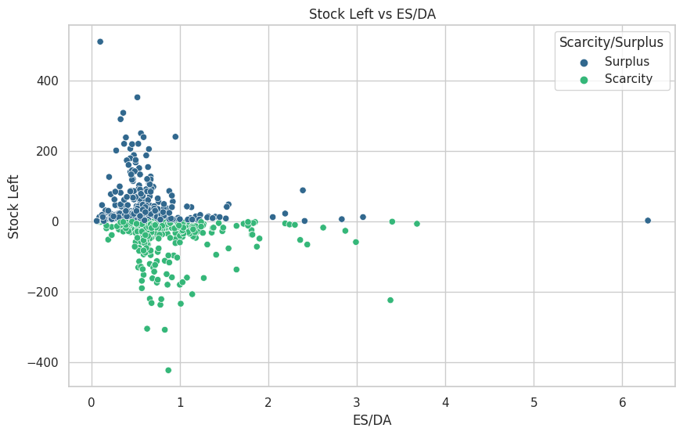
K-Means Clustering

Slide 20
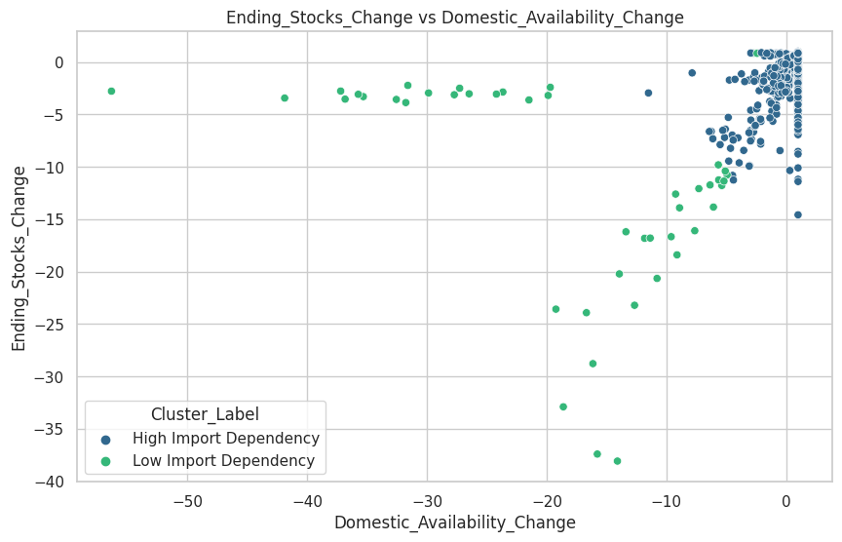
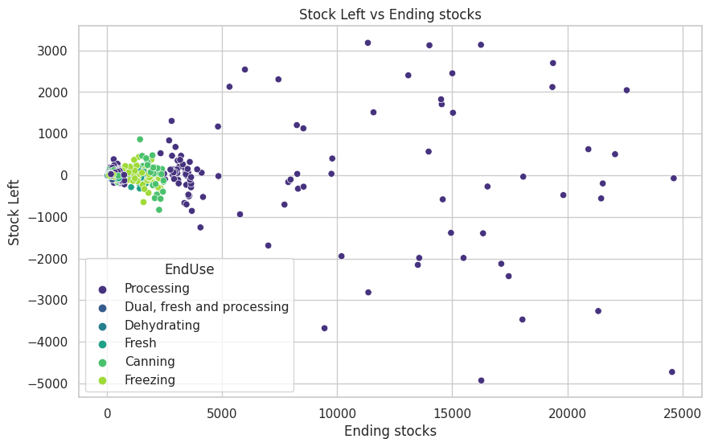
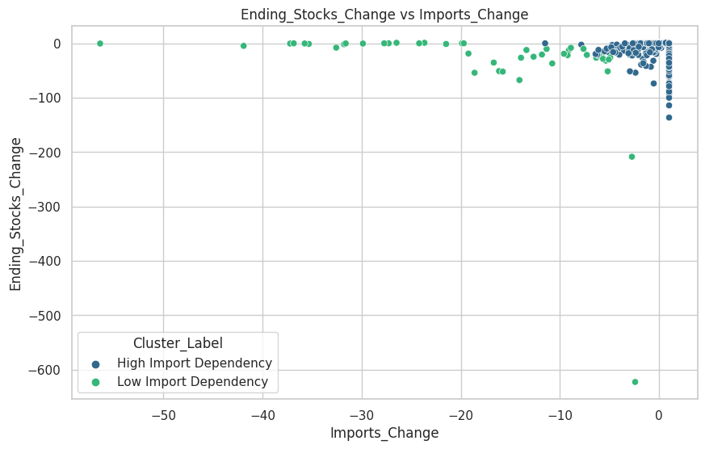
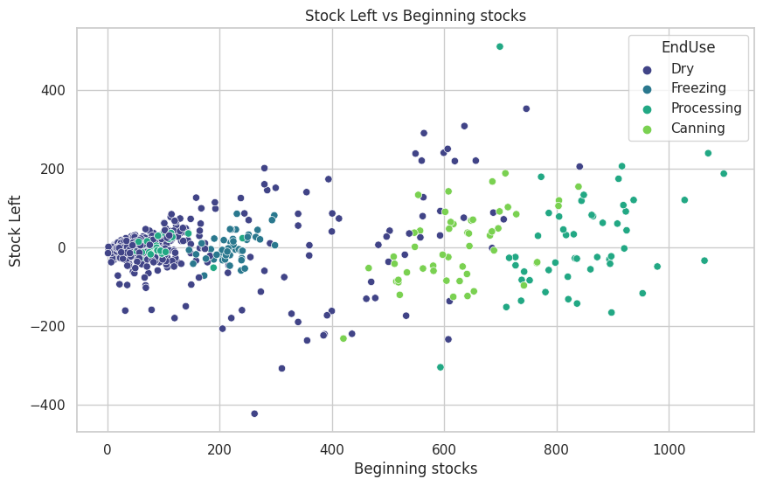
K-Means Clustering

Slide 21



Forecasting With ARIMA Model
Statistical Tests
Scalar Normalization
Feature Selection
ARIMA Modelling
Forecasting Metrics
S3 Bucket
Diagnostic Tests

Slide 22
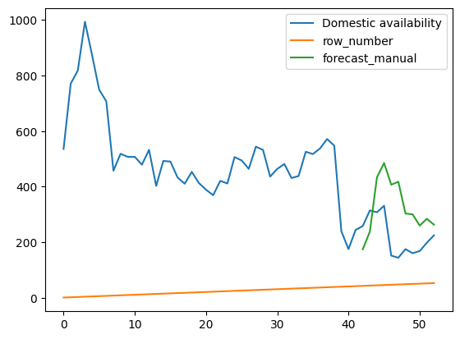
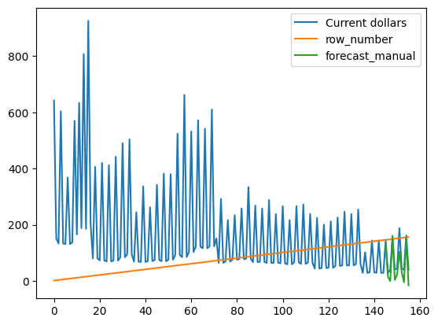
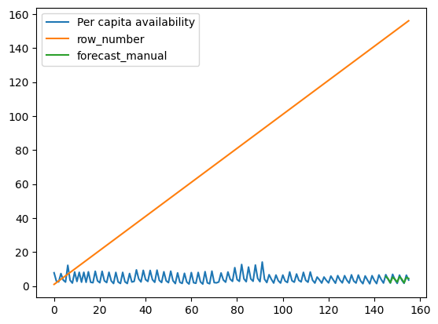
Forecasting With ARIMA Model

Slide 23
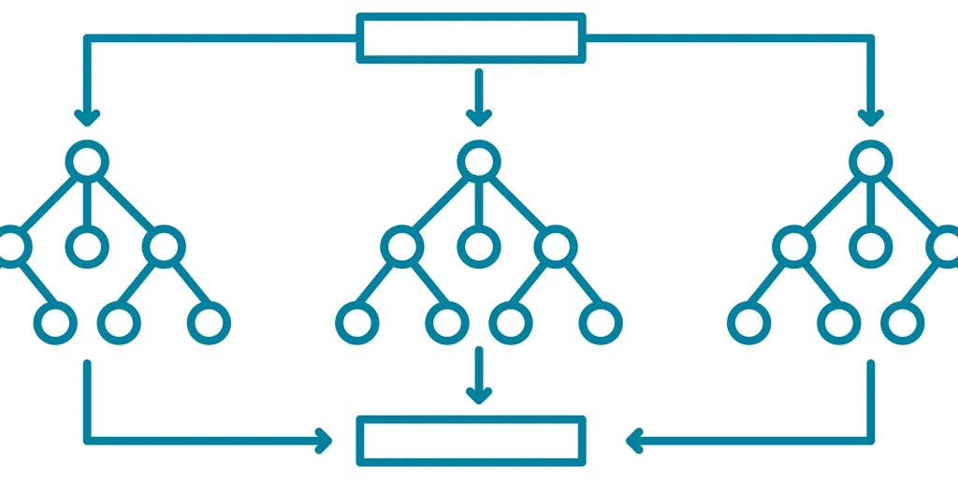
CLASSIFICATION With Random Forest Classifier
Scalar Normalization
Feature Selection
Random forest classifier
Classified Metrics
Evaluation Metrics by using ROC Curve & Confusion Matrix
S3 Bucket

Slide 24
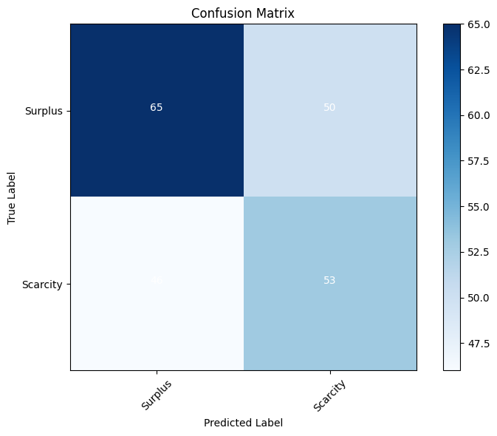
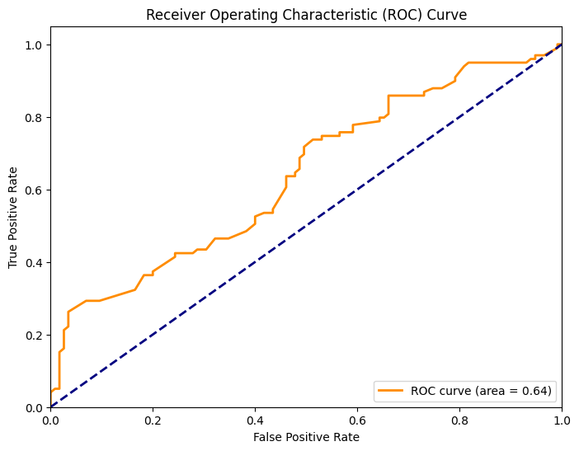
Random Forest Classifier

Slide 25
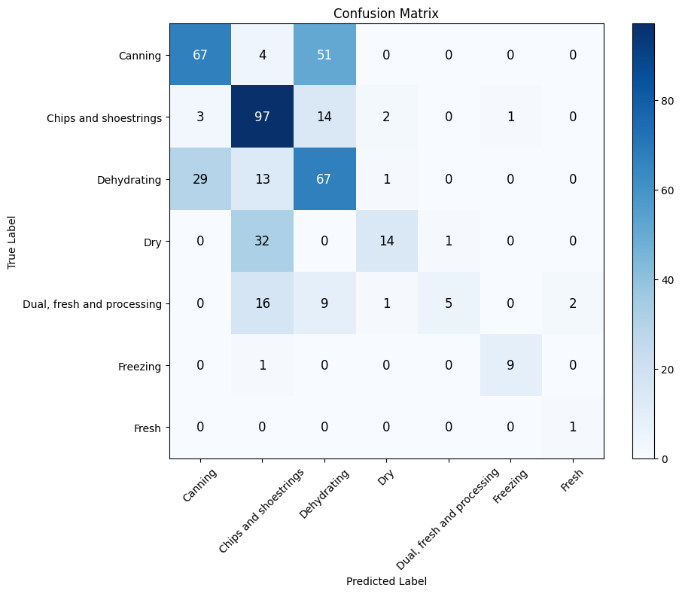
Random Forest Classifier

Slide 26
RESOURCES
[1] Davis, Wilma V., Catharine Weber, Seth Wechsler, Helen Wakefield, and Gary Lucier (2023). Vegetables and pulses yearbook data. Economic Research Service (ERS) USDA.
[2] Amazon Web Services. https://aws.amazon.com
[3] Databricks. https://www.databricks.com
[4] Tableau. https://www.tableau.com
[5] Github. https://github.com

Slide 27

THANK YOU!
Do you have any questions?

